Slide 1

Animal Tracking using ESP32-S3 and ESP-CAM
Presenter:
Huzaifa Shafique (22-NTU-CS-1348)
Hazim Waqar (22-NTU-CS-1346)
Hoor Shumail (22-NTU-CS-1347)
Saad Saddique (22-NTU-CS-1370)

Slide 2
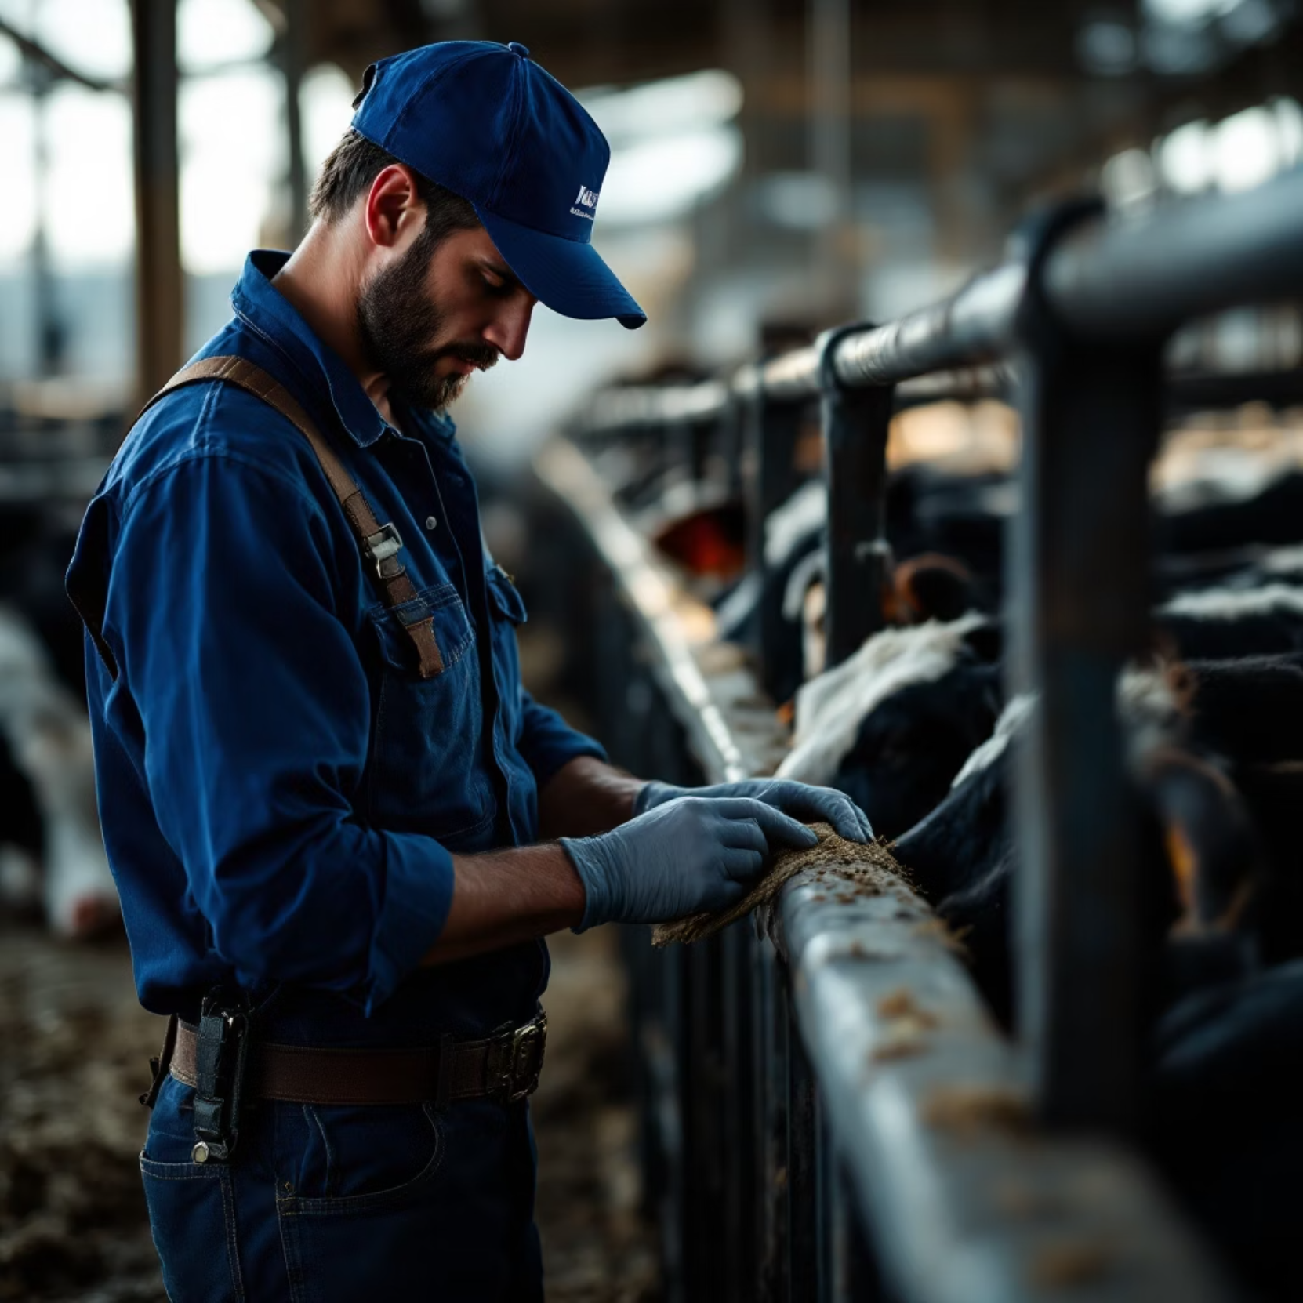
Motivation & Objectives
Motivation:
Manual livestock counting is labor-intensive and error-prone
Need for low-cost, contactless monitoring
Objectives:
Automate entry/exit counts
Classify species on-device
Provide real-time visualization

Slide 3
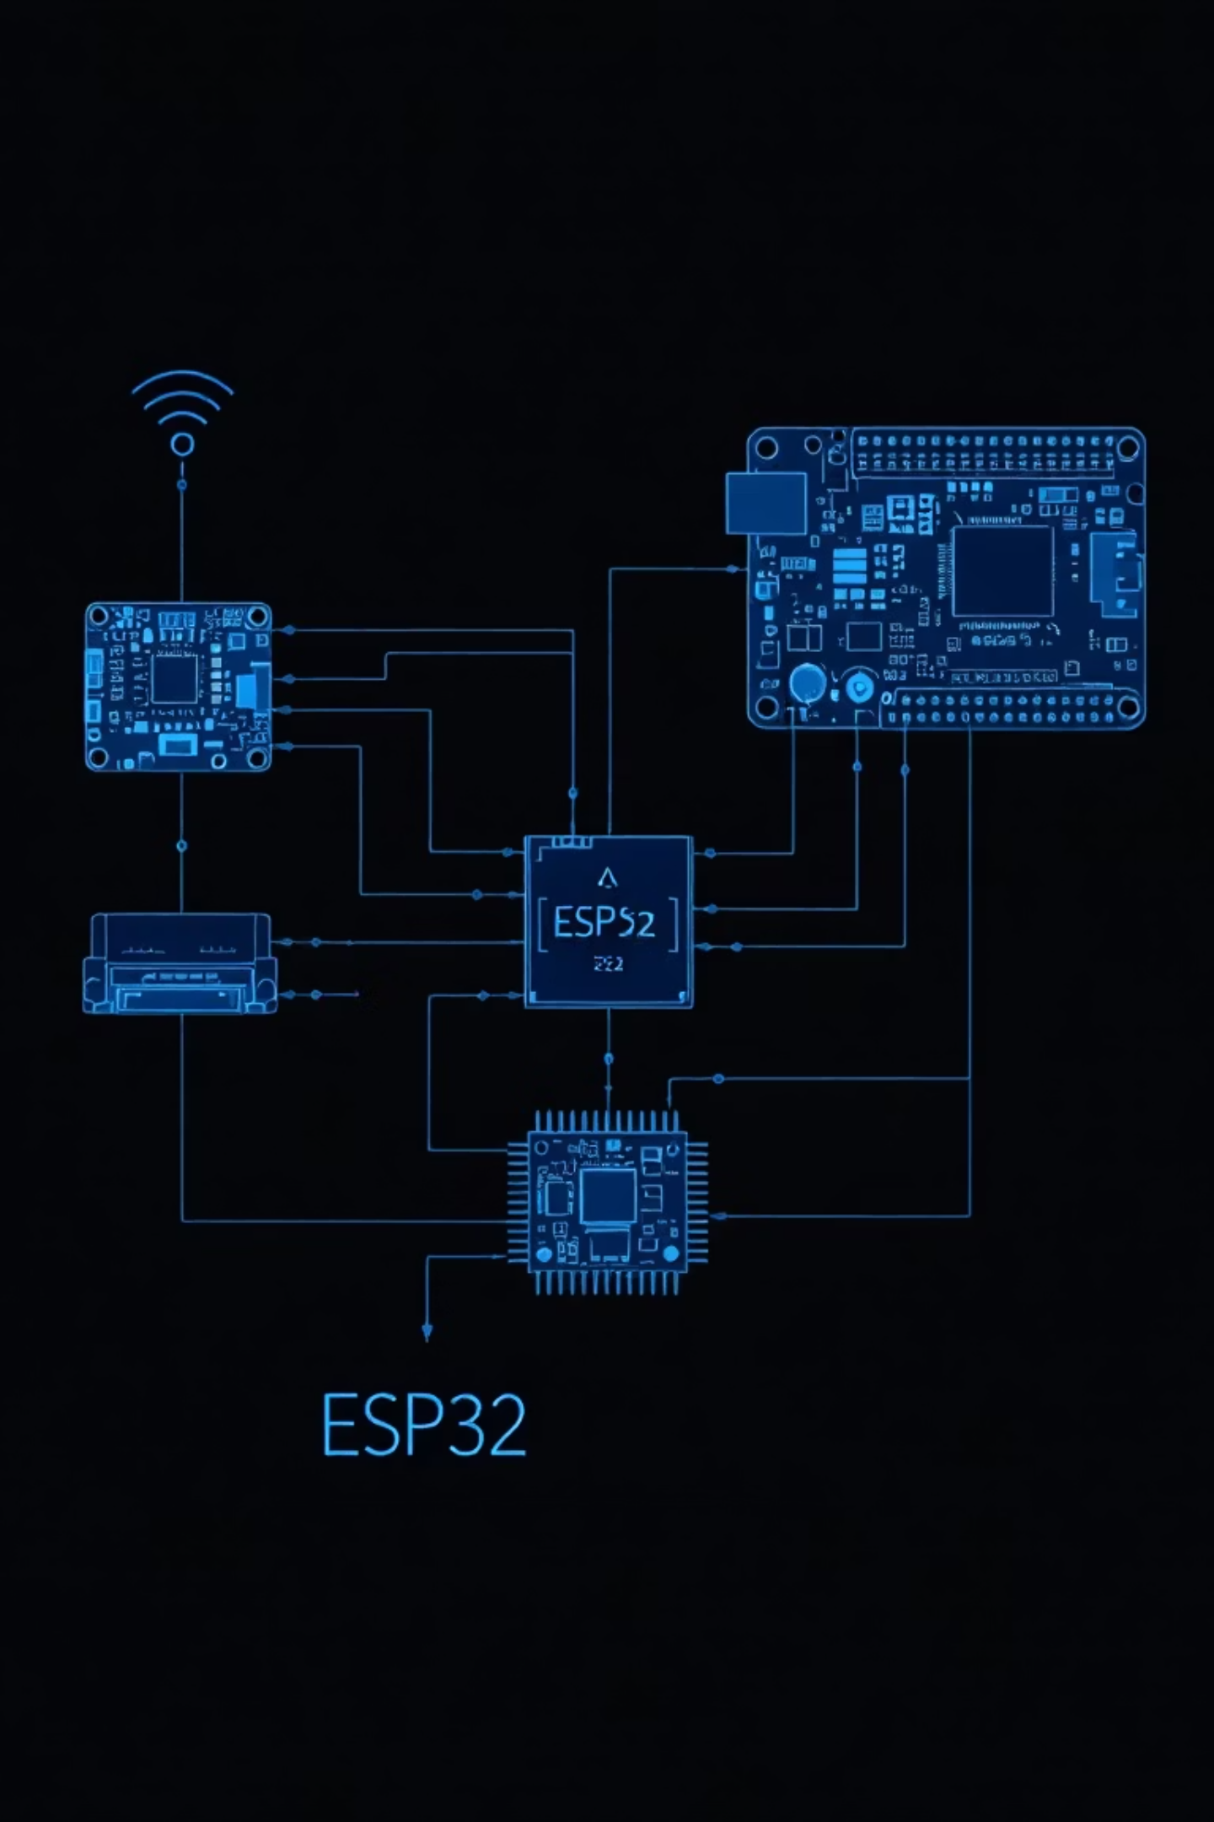




System Architecture
ESP32-CAM
IR-triggered image capture
ESP32-S3
Edge inference (TensorFlow Lite Micro)
Data Flow
HTTP POST → Image decode → Inference → Count update
Visualization
OLED display & Grafana dashboard

Slide 4
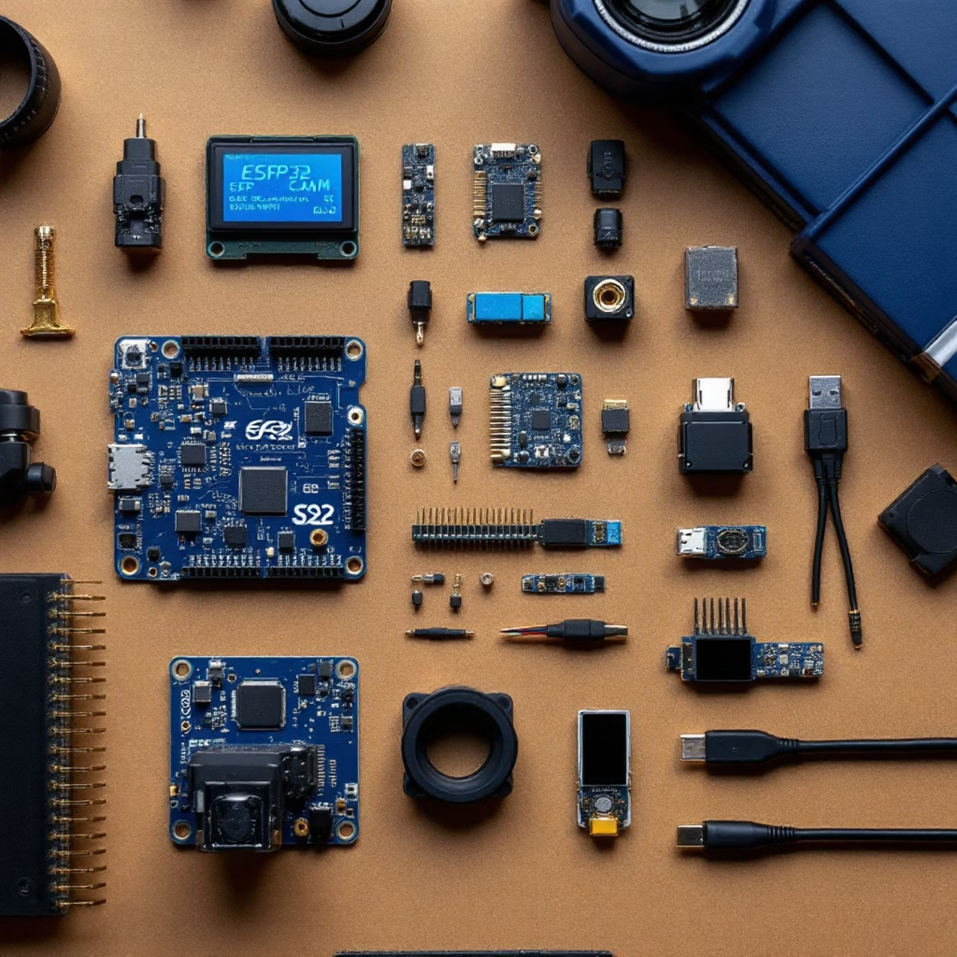
Hardware Components
ESP32-CAM (OV2640 + PSRAM)
ESP32-S3 development board
Two IR obstacle sensors (Sensor A→GPIO 4, Sensor B→GPIO 5)
SSD1306 OLED (I²C: SDA→GPIO 09, SCL→GPIO 08)
3.3 V power rail, common GND

Slide 5
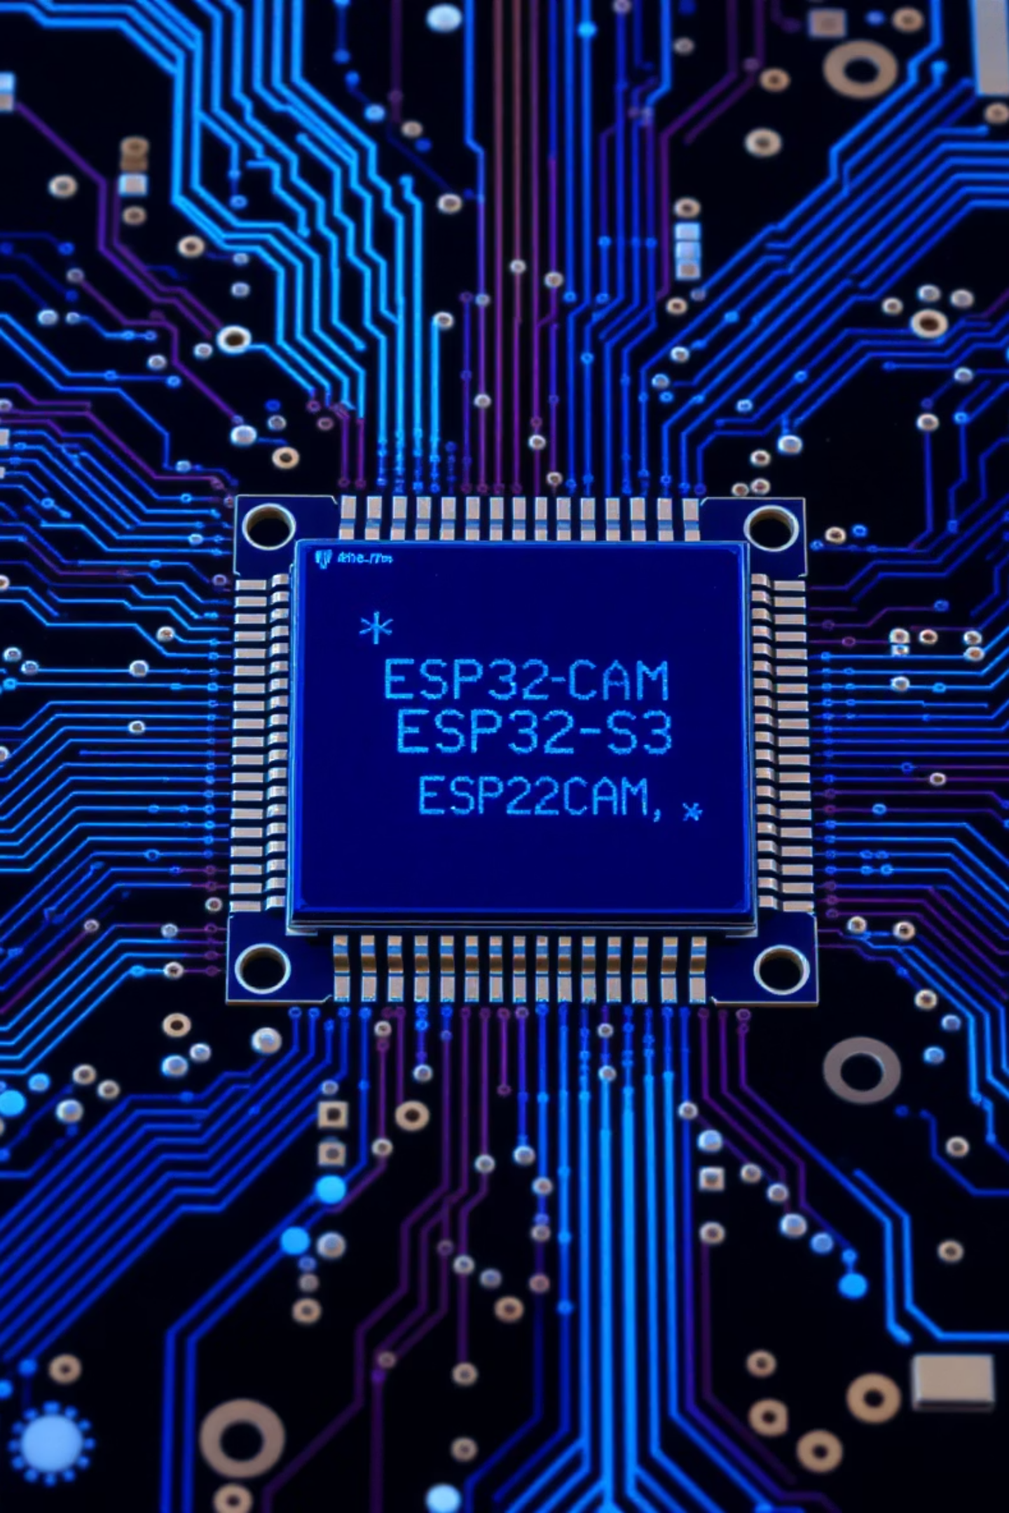
Circuit Diagram (Overview)
IR sensors wired to ESP32-S3
ESP32-CAM ↔ ESP32-S3 over Wi-Fi (HTTP)
OLED on ESP32-S3 I²C bus
Shared 3.3 V and GND

Slide 6
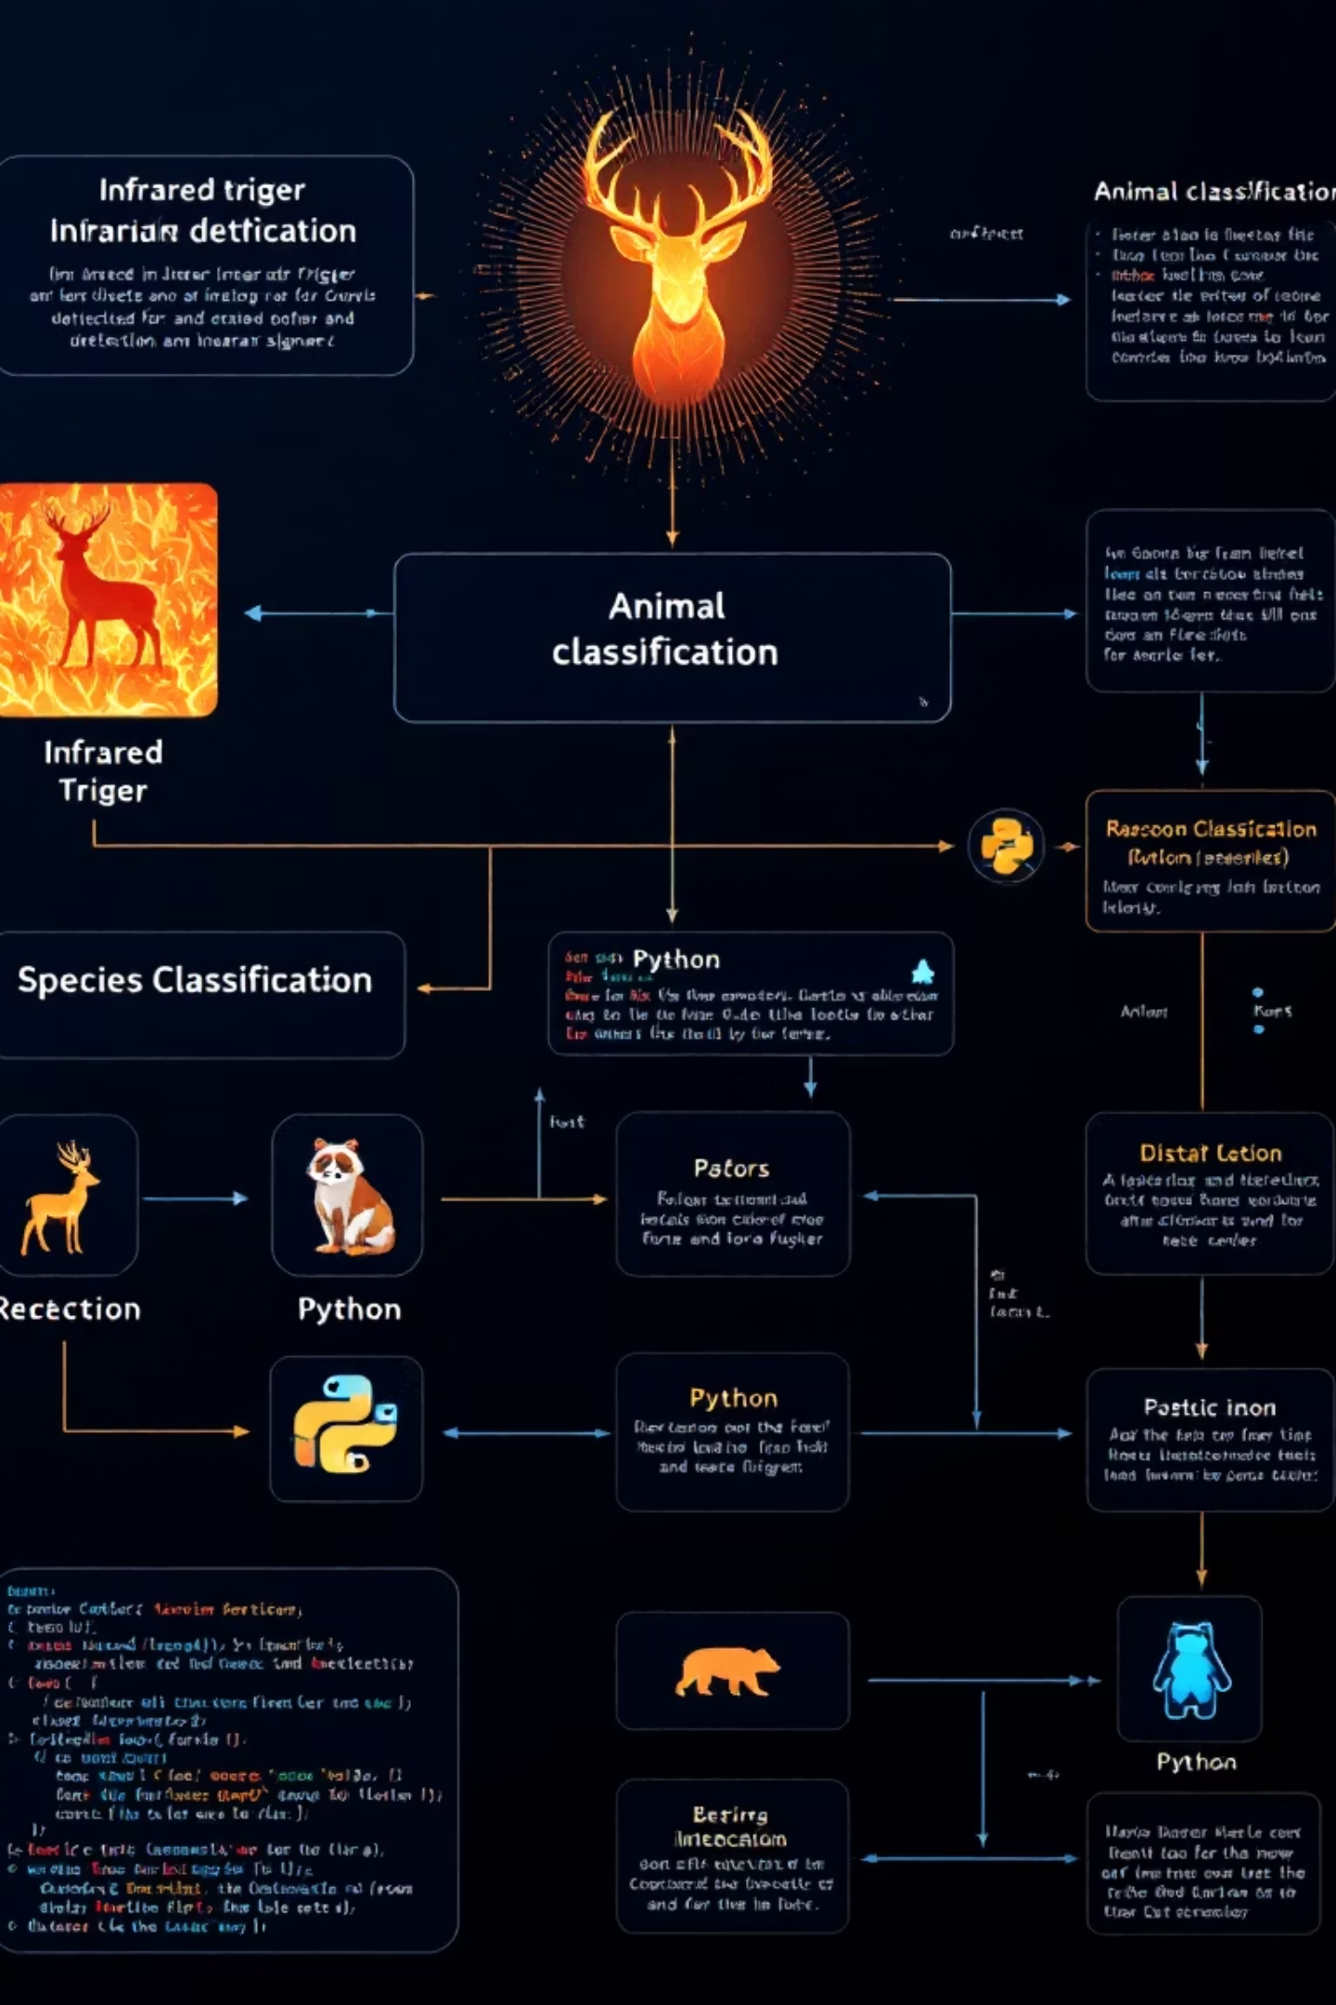
Software Design
Trigger Logic
Detect direction from sensor states
Image Processing
JPEG decode → resize
Model Inference
TensorFlow Lite Micro
Counting Logic
Increment/decrement per direction

Slide 7

Implementation Highlights
Implementation Details:
ESP32-CAM Code: Async web server
ESP32-S3 Code: HTTPClient image receive, TFLM invoke
Memory Management: PSRAM buffers for JPEG data
OLED Output: Counts, Available PSRAM, Confidence Score

Slide 8


Results & Performance
92%
98%
Accuracy
Reliability
On 180-image test set
Consistency over 100 cycles
Latency: ≈150 ms end-to-end
Dashboard: Time-series counts per species

Slide 9

Testing & Limitations
Test Cases:
Limitations:
Single animal entry/exit
Performance drops in low light
Rapid successive triggers
Only four species supported
False positives (both sensors)

Slide 10
Conclusion & Future Work
Conclusion:
Future Work:
Edge-AI on ESP32-S3 is practical for real-time classification
Add IR illumination for night operation
Cloud-based model updates
HTTP streaming → InfluxDB/Grafana avoids MQTT setup
Mobile app notifications and alerts

Slide 11
Thank You

